Slide 1
IP Addresses
Network Layer:
Logical Addressing

Slide 2
CONTENTS
  Introduction
  Classful addressing
    Different network classes
    Subnetting
  Classless addressing
    Supernetting
    CIDR (classless interdomain routing)

Slide 3
INTRODUCTION

Slide 4

What is an IP Address?
An IP address is a
32-bit
address.
The IP addresses
are
unique.

Slide 5
Address Space
…………..
…………..
addr1
addr15
addr2
…………..
…………..
…………..
addr41
addr226
addr31
…………..
…………..

Slide 6
Address space rule
…………..
…………..
addr1
addr15
addr2
…………..
The address space in a protocol
That uses N-bits to define an
Address is:
        2^{N}
…………..
…………..
addr41
addr226
addr31
…………..
…………..

Slide 7
IPv4 address space
The address space of IPv4 is
2³²
or
4,294,967,296.

Slide 8
Binary Notation
01110101 10010101 00011101 11101010

Slide 9
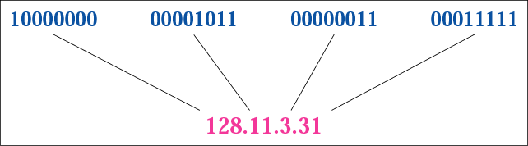
Figure 4-1
Dotted-decimal notation

Slide 10
Hexadecimal Notation
0111 0101 1001 0101 0001 1101 1110 1010
75 95 1D EA
0x75951DEA

Slide 11
Example 1
Change the following IP address from binary notation to dotted-decimal notation.
10000001 00001011 00001011 11101111
Solution
129.11.11.239

Slide 12
Example 2
Change the following IP address from dotted-decimal notation to binary notation:
111.56.45.78
Solution
01101111 00111000 00101101 01001110

Slide 13
Example 3
Find the error in the following IP Address
111.56.045.78
Solution
There are no leading zeroes in
Dotted-decimal notation (045)

Slide 14
Example 3 (continued)
Find the error in the following IP Address
75.45.301.14
Solution
In decimal notation each number <= 255
301 is out of the range

Slide 15
Example 4
Change the following binary IP address
Hexadecimal notation
10000001 00001011 00001011 11101111
Solution
0X810B0BEF or 810B0BEF16

Slide 16
CLASSFUL
ADDRESSING

Slide 17
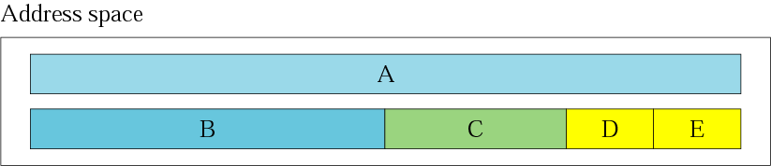
Figure 4-2
Occupation of the address space

Slide 18
In classful addressing the address space is
divided into 5 classes:
A, B, C, D, and E.

Slide 19
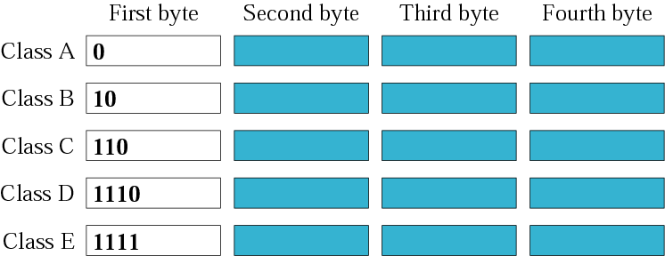
Figure 4-3
Finding the class in binary notation

Slide 20
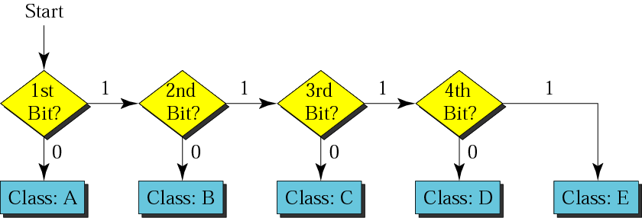
Figure 4-4
Finding the address class

Slide 21
Example 5
Show that Class A has
2³¹ = 2,147,483,648 addresses

Slide 22
Example 6
Find the class of the following IP addresses
00000001 00001011 00001011 11101111
11000001 00001011 00001011 11101111
Solution
00000001 00001011 00001011 11101111
1st is 0, hence it is Class A
11000001 00001011 00001011 11101111
1st and 2nd bits are 1, and 3rd bit is 0 hence, Class C

Slide 23

Figure 4-5
Finding the class in decimal notation

Slide 24
Example 7
Find the class of the following addresses
158.223.1.108
227.13.14.88
Solution
158.223.1.108
1st byte = 158 (128<158<191) class B
227.13.14.88
1st byte = 227 (224<227<239) class D

Slide 25
IP address with appending port number
158.128.1.108:25
the for octet before colon is the IP address
The number of colon (25) is the port number

Slide 26
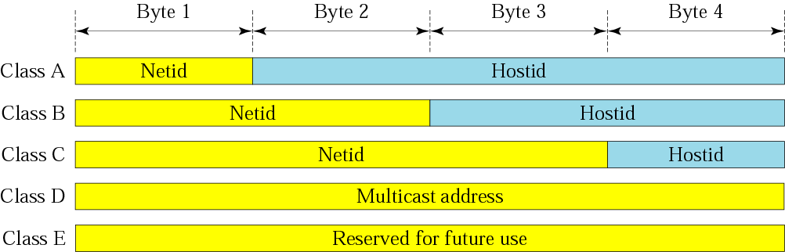
Figure 4-6
Netid and hostid

Slide 27
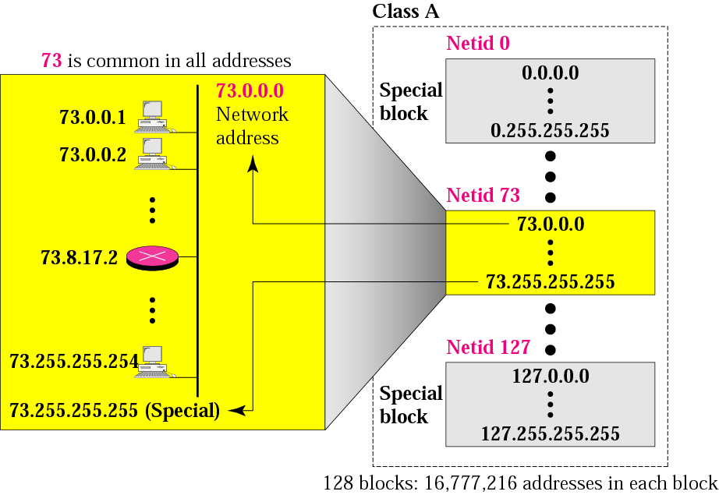
Figure 4-7
Blocks in class A

Slide 28
Millions of class A addresses
are wasted.

Slide 29
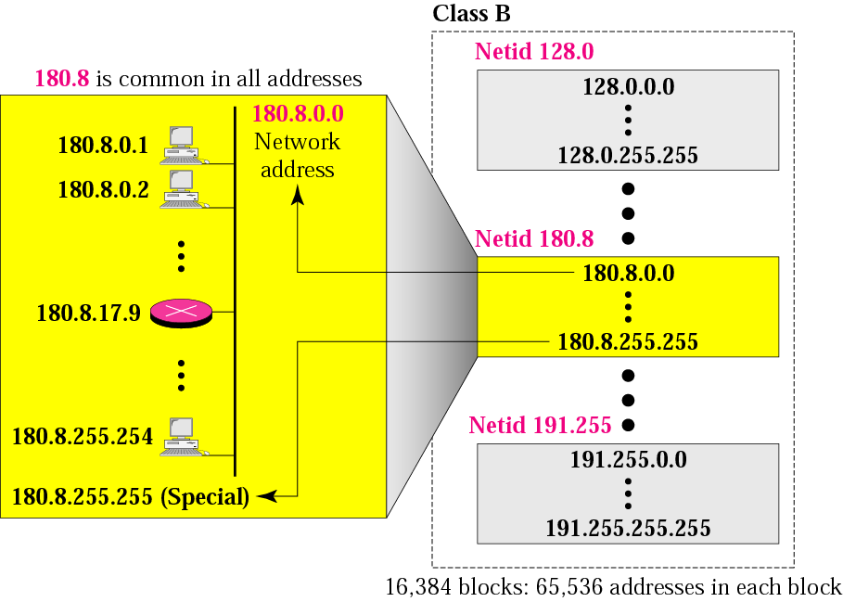
Figure 4-8
Blocks in class B

Slide 30
Many class B addresses
are wasted.

Slide 31
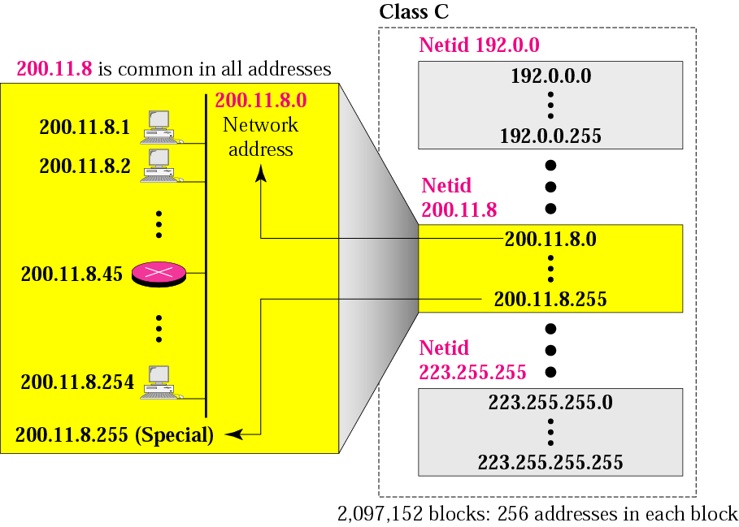
Figure 4-9
Blocks in class C

Slide 32
The number of addresses in
a class C block
is smaller than
the needs of most organizations.

Slide 33
Class D addresses
are used for multicasting;
there is only
one block in this class.

Slide 34
Class E addresses are reserved
for special purposes;
most of the block is wasted.

Slide 35
Network Addresses
The network address is the first address.
The network address defines the network to the rest of the Internet.
Given the network address, we can find the class of the address, the block, and the range of the addresses in the block

Slide 36
In classful addressing,
the network address
(the first address in the block)
is the one that is assigned
to the organization.

Slide 37
Example 8
Given the network address 132.21.0.0, find the
class, the block, and the range of the addresses
Solution
The 1st byte is between 128 and 191.
Hence, Class B
The block has a netid of 132.21.
The addresses range from
132.21.0.0 to 132.21.255.255.

Slide 38
Mask
A mask is a 32-bit binary number.
The mask is ANDeD with IP address to get
  The bloc address (Network address)
  Mask And IP address = Block Address

Slide 39
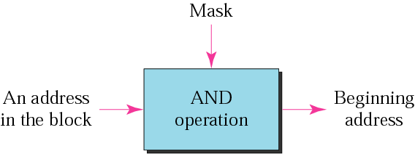
Figure 4-10
Masking concept

Slide 40
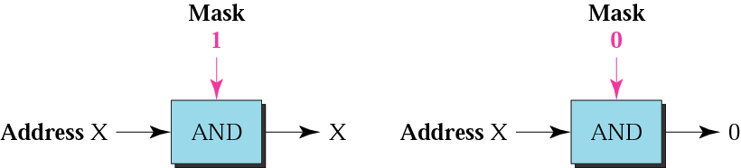
Figure 4-11
AND operation

Slide 41
The network address is the
beginning address of each block.
It can be found by applying
the default mask to
any of the addresses in the block
(including itself).
It retains the netid of the block
and sets the hostid to zero.

Slide 42
Default Mak
Class A default mask is 255.0.0.0
Class B default mask is 255.255.0.0
Class C Default mask 255.255.255.0

Slide 43
Subnetting/Supernetting
and
Classless Addressing

Slide 44
CONTENTS
Subnetting
Supernetting
Classless addrssing

Slide 45
Subnetting

Slide 46
IP addresses are designed with
two levels of hierarchy.

Slide 47
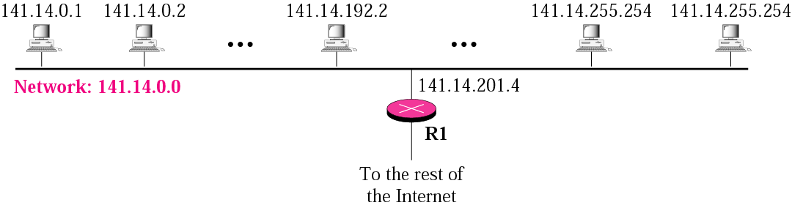
Figure 5-1
A network with two levels of
hierarchy (not subnetted)

Slide 48
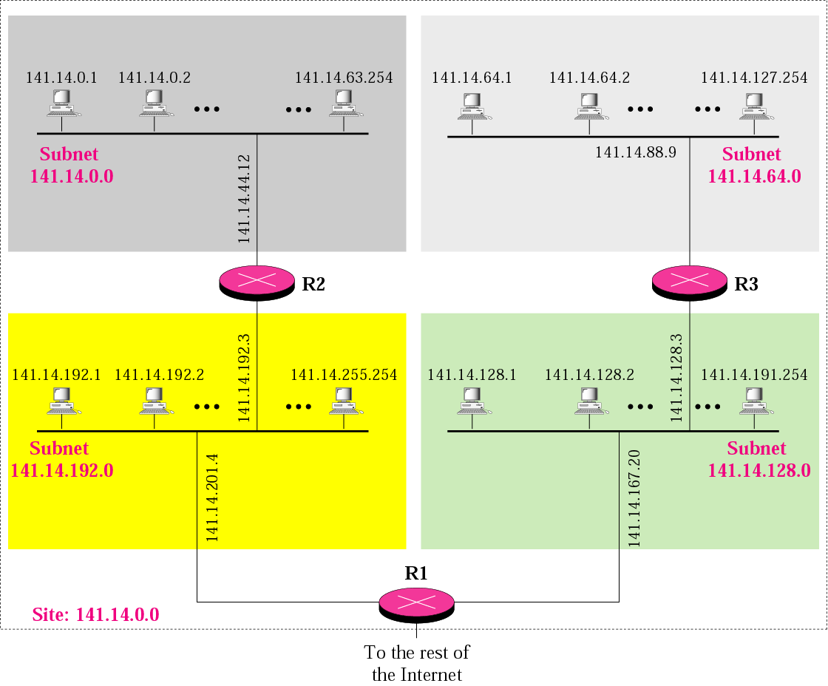
Figure 5-2
A network with three levels of
hierarchy (subnetted)

Slide 49
Note
Subnetting is done by borrowing bits from the host part and add them the network part

Slide 50
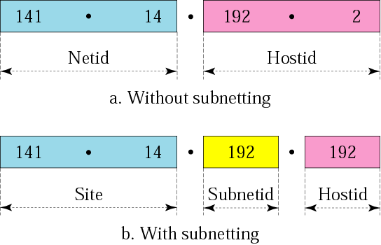
Figure 5-3
Addresses in a network with
and without subnetting

Slide 51
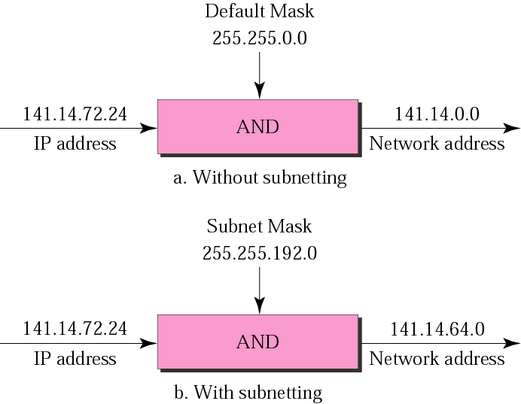
Figure 5-5
Default mask and subnet mask

Slide 52
Finding the Subnet Address
Given an IP address, we can find the subnet address the same way we found the network address. We apply the mask to the address. We can do this in two ways: straight or short-cut.

Slide 53
Straight Method
In the straight method, we use binary notation for both the address and the mask and then apply the AND operation to find the subnet address.

Slide 54
Example 9
What is the subnetwork address if the destination address is 200.45.34.56 and the subnet mask is 255.255.240.0?

Slide 55
Solution
11001000 00101101 00100010 00111000
11111111 11111111 11110000 00000000
11001000 00101101 00100000 00000000
The subnetwork address is 200.45.32.0.

Slide 56
Short-Cut Method
    ** If the byte in the mask is 255, copy the byte in the address.
    ** If the byte in the mask is 0, replace the byte in the address with 0.
    ** If the byte in the mask is neither 255 nor 0, we write the mask and the address in binary and apply the AND operation.

Slide 57
Example 10
What is the subnetwork address if the destination address is 19.30.80.5 and the mask is 255.255.192.0?
Solution
See next slide

Slide 58
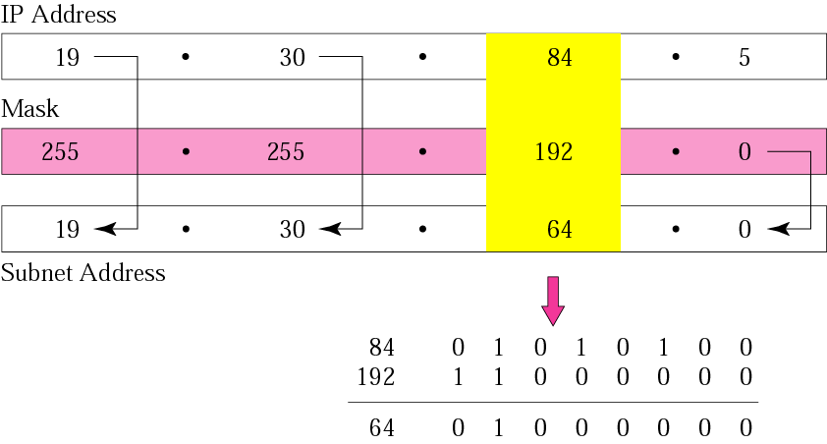
Figure 5-6
Solution

Slide 59
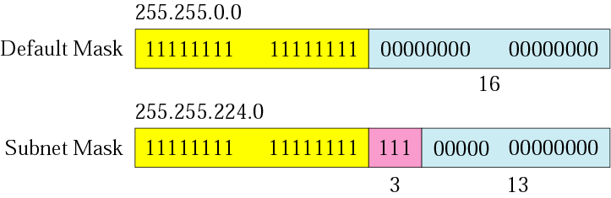
Figure 5-7
Comparison of a default mask and
a subnet mask

Slide 60
The number of subnets must be
a power of 2.

Slide 61
Example 11
A company is granted the site address 201.70.64.0 (class C). The company needs six subnets. Design the subnets.
Solution
The number of 1s in the default
mask is 24 (class C).

Slide 62
Solution (Continued)
The company needs six subnets. This number 6 is not a power of 2. The next number that is a power of 2 is 8 (2³). We need 3 more 1s in the subnet mask. The total number of 1s in the subnet mask is 27 (24 + 3).
The total number of 0s is 5 (32 − 27). The mask is

Slide 63
Solution (Continued)
11111111 11111111 11111111 11100000
or
255.255.255.224
    The number of subnets is 8.
    The number of addresses in each subnet is 2⁵ (5 is the number of 0s) or 32.
See Next slide

Slide 64
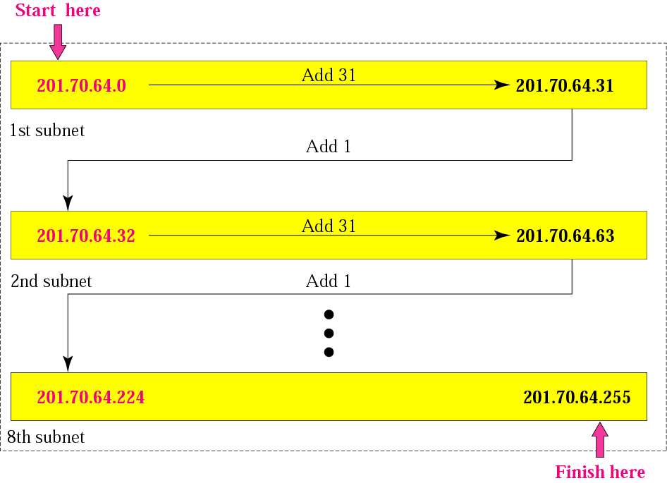
Figure 5-8
Example 3

Slide 65
Example 12
A company is granted the site address 181.56.0.0 (class B). The company needs 1000 subnets. Design the subnets.
Solution
The number of 1s in the default mask is 16 (class B).

Slide 66
Solution (Continued)
The company needs 1000 subnets. This number is not a power of 2. The next number that is a power of 2 is 1024 (2¹⁰). We need 10 more 1s in the subnet mask.
The total number of 1s in the subnet mask is 26 (16 + 10).
The total number of 0s is 6 (32 − 26).

Slide 67
Solution (Continued)
The mask is
11111111 11111111 11111111 11000000
or
255.255.255.192.
The number of subnets is 1024.
The number of addresses in each subnet is 2⁶ (6 is the number of 0s) or 64.
See next slide

Slide 68
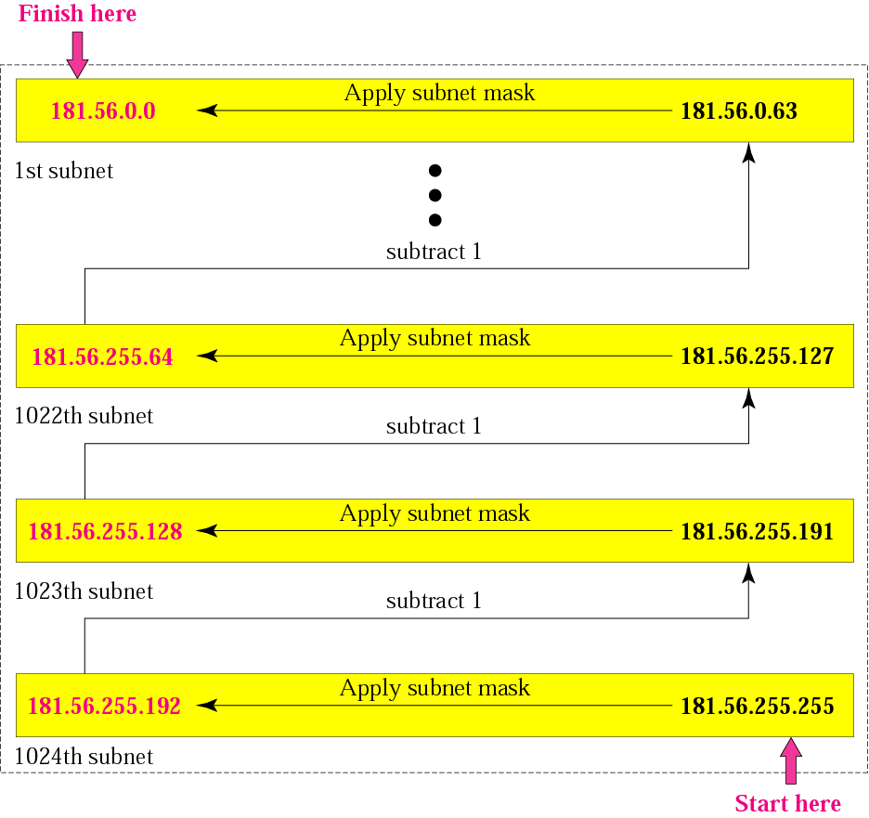
Figure 5-9
Example 4

Slide 69
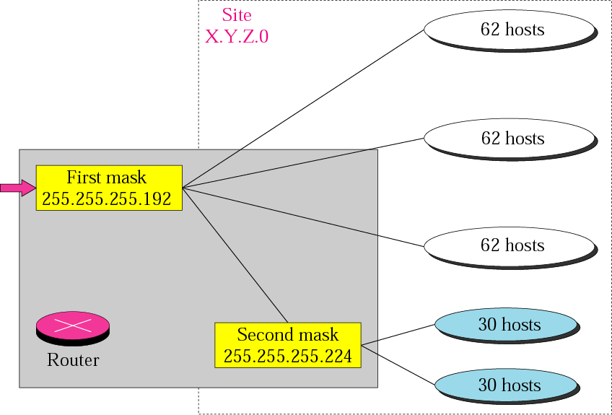
Figure 5-10
Variable-length subnetting

Slide 70
Supernetting

Slide 71
What is suppernetting?
Supernetting is the opposite of subnetting
In subnetting you borrow bits from the host part
Supernetting is done by borrowing bits from the network side.
And combine a group of networks into one large supernetwork.

Slide 72
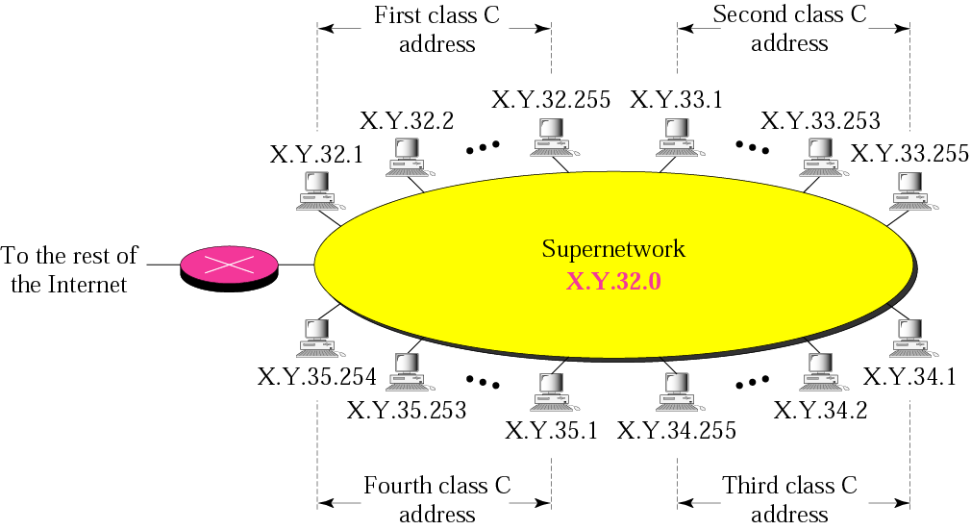
Figure 5-11
A supernetwork

Slide 73
Rules:
❐ The number of blocks must be a power of 2 (1, 2, 4, 8, 16, . . .).
❐ The blocks must be contiguous in the address space (no gaps between the blocks).
❐ The third byte of the first address in the superblock must be evenly divisible by the number of blocks. In other words, if the number of blocks is N, the third byte must be divisible by N.

Slide 74
Example 5
A company needs 600 addresses. Which of the following set of class C blocks can be used to form a supernet for this company?
198.47.32.0 198.47.33.0 198.47.34.0
198.47.32.0 198.47.42.0 198.47.52.0 198.47.62.0
198.47.31.0 198.47.32.0 198.47.33.0 198.47.52.0
198.47.32.0 198.47.33.0 198.47.34.0 198.47.35.0

Slide 75
Solution
1: No, there are only three blocks.
2: No, the blocks are not contiguous.
3: No, 31 in the first block is not divisible by 4.
4: Yes, all three requirements are fulfilled.

Slide 76
In subnetting,
we need the first address of the
subnet and the subnet mask to
define the range of addresses.

Slide 77
In supernetting,
we need the first address of
the supernet
and the supernet mask to
define the range of addresses.

Slide 78
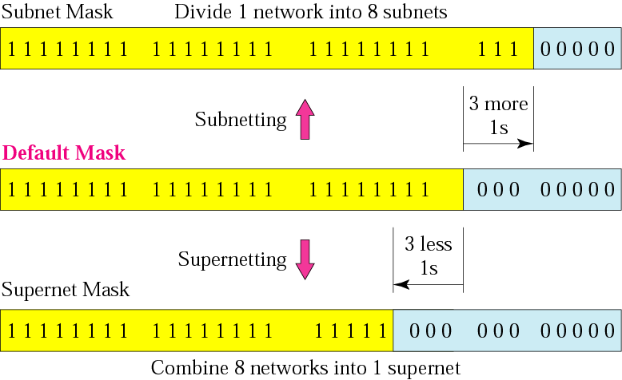
Figure 5-12
Comparison of subnet, default,
and supernet masks

Slide 79
Example 13
We need to make a supernetwork out of 16 class C blocks. What is the supernet mask?
Solution
We need 16 blocks. For 16 blocks we need to change four 1s to 0s in the default mask. So the mask is
11111111 11111111 11110000 00000000
or
255.255.240.0

Slide 80
Example 14
A supernet has a first address of 205.16.32.0 and a supernet mask of 255.255.248.0. A router receives three packets with the following destination addresses:
    205.16.37.44
    205.16.42.56
    205.17.33.76
Which packet belongs to the supernet?

Slide 81
Solution
We apply the supernet mask to see if we can find the beginning address.
205.16.37.44 AND 255.255.248.0 ➔  205.16.32.0
205.16.42.56 AND 255.255.248.0 ➔  205.16.40.0
205.17.33.76 AND 255.255.248.0 ➔  205.17.32.0
Only the first address belongs to this supernet.

Slide 82
Example 15
A supernet has a first address of 205.16.32.0 and a supernet mask of 255.255.248.0. How many blocks are in this supernet and what is the range of addresses?
Solution
The supernet has 21 1s. The default mask has 24 1s. Since the difference is 3, there are 2³ or 8 blocks in this supernet. The blocks are 205.16.32.0 to 205.16.39.0. The first address is 205.16.32.0. The last address is 205.16.39.255.a

Slide 83
CLASSLESS
ADDRESSING

Slide 84
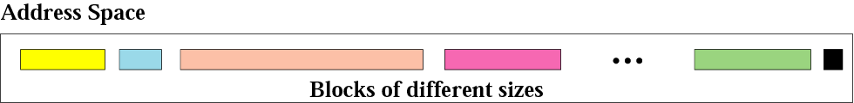
Figure 5-13
Variable-length blocks

Slide 85
Number of Addresses in a Block
There is only one condition on the number of addresses in a block; it must be a power of 2 (2, 4, 8, . . .). A household may be given a block of 2 addresses. A small business may be given 16 addresses. A large organization may be given 1024 addresses.

Slide 86
Beginning Address
The beginning address must be evenly divisible by the number of addresses. For example, if a block contains 4 addresses, the beginning address must be divisible by 4. If the block has less than 256 addresses, we need to check only the rightmost byte. If it has less than 65,536 addresses, we need to check only the two rightmost bytes, and so on.

Slide 87
Example 16
Which of the following can be the beginning address of a block that contains 1024 addresses?
205.16.37.32
190.16.42.0
17.17.32.0
123.45.24.52
Solution
To be divisible by 1024, the rightmost byte of an address should be 0 and the second rightmost byte must be divisible by 4. Only the address 17.17.32.0 meets this condition.

Slide 88
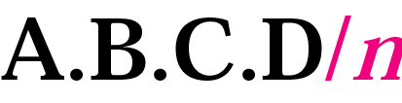
Figure 5-14
Slash notation

Slide 89
Slash notation is also called
CIDR
notation.

Slide 90
Example 17
A small organization is given a block with the beginning address and the prefix length 205.16.37.24/29 (in slash notation). What is the range of the block?

Slide 91
Solution
The beginning address is 205.16.37.24. To find the last address we keep the first 29 bits and change the last 3 bits to 1s.
Beginning: 11001111 00010000 00100101 00011000
Ending : 11001111 00010000 00100101 00011111
There are only 8 addresses in this block.

Slide 92
Example 17 cont’d
We can find the range of addresses in Example 17 by another method. We can argue that the length of the suffix is 32 − 29 or 3. So there are 2³ = 8 addresses in this block. If the first address is 205.16.37.24, the last address is 205.16.37.31 (24 + 7 = 31).

Slide 93
A block in classes A, B, and C
can easily be represented in slash
notation as
A.B.C.D/ n
where n is
either 8 (class A), 16 (class B), or
24 (class C).

Slide 94
Example 18
What is the network address if one of the addresses is 167.199.170.82/27?
Solution
The prefix length is 27, which means that we must keep the first 27 bits as is and change the remaining bits (5) to 0s. The 5 bits affect only the last byte. The last byte is 01010010. Changing the last 5 bits to 0s, we get 01000000 or 64. The network address is 167.199.170.64/27.

Slide 95
Example 19
An organization is granted the block 130.34.12.64/26. The organization needs to have four subnets. What are the subnet addresses and the range of addresses for each subnet?
Solution
The suffix length is 6. This means the total number of addresses in the block is 64 (2⁶). If we create four subnets, each subnet will have 16 addresses.

Slide 96
Solution (Continued)
Let us first find the subnet prefix (subnet mask). We need four subnets, which means we need to add two more 1s to the site prefix. The subnet prefix is then /28.
Subnet 1: 130.34.12.64/28 to 130.34.12.79/28.
Subnet 2 : 130.34.12.80/28 to 130.34.12.95/28.
Subnet 3: 130.34.12.96/28 to 130.34.12.111/28.
Subnet 4: 130.34.12.112/28 to 130.34.12.127/28.
See Figure

Slide 97
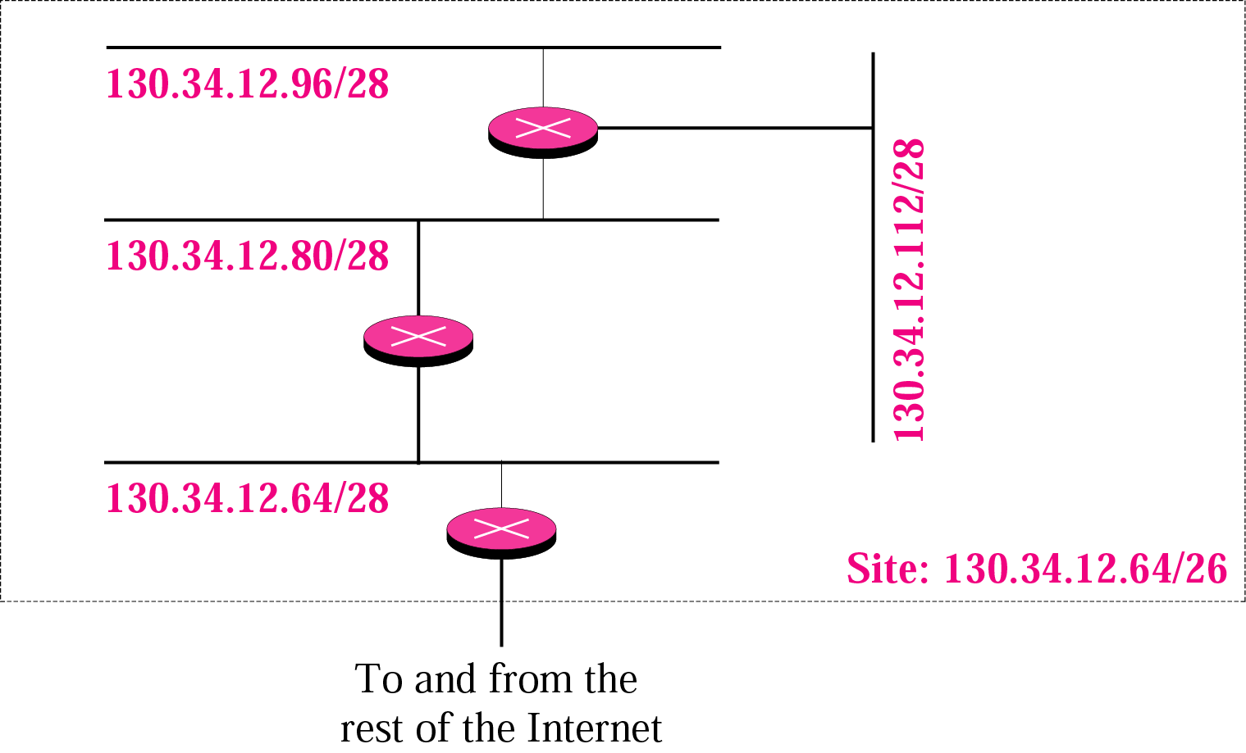
Figure 5-15
Example 19 cont’d

Slide 98
Example 20
An ISP is granted a block of addresses starting with 190.100.0.0/16. The ISP needs to distribute these addresses to three groups of customers as follows:
1. The first group has 64 customers; each needs 256 addresses.
2. The second group has 128 customers; each needs 128 addresses.
3. The third group has 128 customers; each needs 64 addresses.
Design the subblocks and give the slash notation for each subblock. Find out how many addresses are still available after these allocations.

Slide 99
Solution
Group 1
For this group, each customer needs 256 addresses. This means the suffix length is 8 (2⁸ = 256). The prefix length is then 32 − 8 = 24.
01: 190.100.0.0/24  ➔190.100.0.255/24
02: 190.100.1.0/24 ➔190.100.1.255/24
…………………………………..
64: 190.100.63.0/24➔190.100.63.255/24
Total = 64 × 256 = 16,384

Slide 100
Solution (Continued)
Group 2
For this group, each customer needs 128 addresses. This means the suffix length is 7 (2⁷ = 128). The prefix length is then 32 − 7 = 25. The addresses are:
001: 190.100.64.0/25 ➔190.100.64.127/25
002: 190.100.64.128/25 ➔190.100.64.255/25
………………..
128: 190.100.127.128/25 ➔190.100.127.255/25
Total = 128 × 128 = 16,384

Slide 101
Solution (Continued)
Group 3
For this group, each customer needs 64 addresses. This means the suffix length is 6 (2⁶ = 64). The prefix length is then 32 − 6 = 26.
001:190.100.128.0/26 ➔190.100.128.63/26
002:190.100.128.64/26 ➔190.100.128.127/26
…………………………
128:190.100.159.192/26 ➔190.100.159.255/26
Total = 128 × 64 = 8,192

Slide 102
Solution (Continued)
Number of granted addresses: 65,536
Number of allocated addresses: 40,960
Number of available addresses: 24,576

Slide 103
For, 192.168.10.0/29, Find 10th, 16th and 22nd subnet.
Network | Prefix | Suffix 16 8 4 2 1 | Suffix
Network address | 192.168.10 | 0 0 0 0 0 | 0 0 0
First host | 192.168.10 | 0 0 0 0 0(0) | 0 0 1
last host | 192.168.10 | 0 0 0 0 0 | 1 1 0
Broadcast address | 192.168.10 | 0 0 0 0 0 | 1 1 1
10th Subnet | 192.168.10 | 0 1 0 0 1 (9) | 0 0 0
First host | 192.168.10 | 0 1 0 0 1 | 0 0 1
last host | 192.168.10 | 0 1 0 0 1 | 1 1 0
Broadcast address | 192.168.10 | 0 1 0 0 1 | 1 1 1

Slide 104
192.168.10.0/29
16th Subnet | 192.168.10 | 0 1 1 1 1 (15) | 0 0 0
First host | 192.168.10 | 0 1 1 1 1 | 0 0 1
last host | 192.168.10 | 0 1 1 1 1 | 1 1 0
Broadcast address | 192.168.10 | 0 1 1 1 1 | 1 1 1
22th Subnet | 192.168.10 | 1 0 1 0 1 (21) | 0 0 0
First host | 192.168.10 | 1 0 1 0 1 | 0 0 1
last host | 192.168.10 | 1 0 1 0 1 | 1 1 0
Broadcast address | 192.168.10 | 1 0 1 0 1 | 1 1 1

Slide 105
Special Addresses
we need to mention five special addresses that are used for special purposes: this-host address, limited-broadcast address, loopback address, private addresses, and multicast addresses.
This-host Address
The only address in the block 0.0.0.0/32 is called the this-host address. It is used whenever a host needs to send an IP datagram but it does not know its own address to use as the source address.
Limited-broadcast Address
The only address in the block 255.255.255.255/32 is called the limited-broadcast address. It is used whenever a router or a host needs to send a datagram to all devices in that particular network.

Slide 106
Private Addresses
Four blocks are assigned as private addresses:
10.0.0.0/8,
172.16.0.0/12,
192.168.0.0/16, and
169.254.0.0/16.
Multicast Addresses
The block 224.0.0.0/4 is reserved for multicast addresses.

Slide 107

Table Addresses for private networks

Slide 108
Network Address Translation (NAT)
Network Address Translation (NAT) allows a site to use a set of private addresses for internal communication and a set of global Internet addresses (at least one) for communication with the rest of the world.
The site must have only one connection to the global Internet through a NAT-capable router that runs NAT software.
Address Translation The addresses of the outgoing packets and incoming packets going through the NAT router, need to be changed.

Slide 109
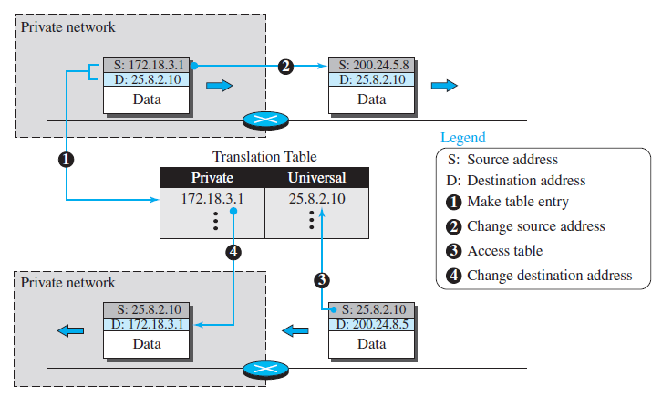
Translation Table: Using one IP Address

Slide 110
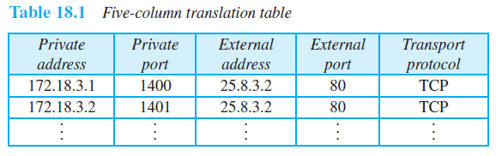
Translation Table: Using both IP Addresses and port addresses
To allow a many-to-many relationship between private-network hosts and external server programs, we need more information in the table.

Slide 111
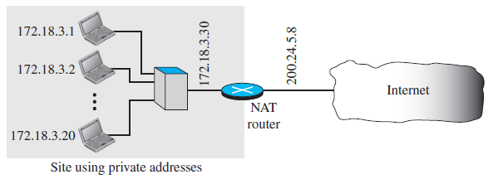
Figure A NAT implementation

Slide 112
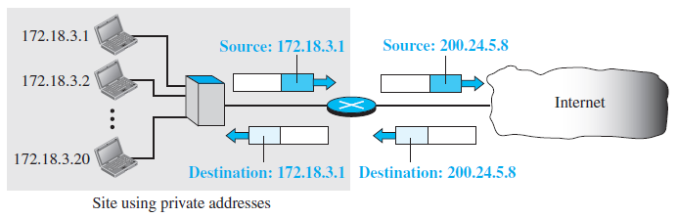
Figure Addresses in a NAT

Slide 113

Figure NAT address translation

Slide 114

Table Five-column translation table

Slide 115

Figure An ISP and NAT

Slide 116
IPv6 ADDRESSES
Despite all short-term solutions, address depletion is still a long-term problem for the Internet. This and other problems in the IP protocol itself have been the motivation for IPv6.
Topics discussed in this section:
Structure
Address Space

Slide 117
An IPv6 address is 128 bits long.

Slide 118

Figure IPv6 address in binary and hexadecimal colon notation

Slide 119

Figure Abbreviated IPv6 addresses

Slide 120

Example
Expand the address 0:15::1:12:1213 to its original.
Solution
We first need to align the left side of the double colon to the left of the original pattern and the right side of the double colon to the right of the original pattern to find how many 0s we need to replace the double colon.
This means that the original address is.

Slide 121

Table Type prefixes for IPv6 addresses

Slide 122

Table Type prefixes for IPv6 addresses (continued)

Slide 123

Figure Prefixes for provider-based unicast address

Slide 124

Figure Multicast address in IPv6

Slide 125

Figure Reserved addresses in IPv6

Slide 126

Figure Local addresses in IPv6

Slide 127
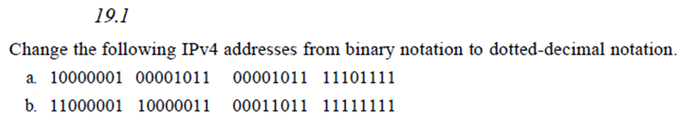
Figure Local addresses in IPv6

Slide 128
Head office:66
Br A: 20
Br B: 30
Wan links : 2
Given 195.20.5.0/24
Design subnetworks.

Slide 129
Hosts 20, 66, 18: So needs, 5,7,5 bits ; 2,2 for routers
_{Host bits 8 7 6 5 4 3 2 1}
Number Hosts: 256 128 64 32 16 8 4 2
1’s positional Val: 128 64 32 16 8 4 2 1
195. 20. 5. 0 0 0 0 0 0 0 0
Subnet | Subnet Address | Subnet Mask | First Usable Address | Last Usable Address | Broad cast address
0 | 195.20.5.0 | /25 | 195.20.5.1 | 195.20.5.126 | 195.20.5.127
1 | 195.20.5.128 | /27 | 195.20.5.129 | 195.20.5.158 | 195.20.5.159
2 | 195.20.5.160 | /27 | 195.20.5.161 | 195.20.5.190 | 195.20.5.191
3 | 195.20.5.192 | /30 | 195.20.5.193 | 195.20.5.194 | 195.20.5.195
4 | 195.20.5.196 | /30 | 195.20.5.197 | 195.20.5.198 | 195.20.5.199

Slide 130
172.16.0.0/22 (classful) are given. Find out 10th subnet with number of subnets hosts in the network.
Host bit: 10
Default network bits=16
Default Host bits=16
Borrowed bits for Subnet from host bits =16-10=6 bits
172 16. 0 0 0 0 0 0 0 0. 0 0 0 0 0 0 0 0
Total subnets=2^6=64
Total Number of Usable Hosts per Subnet:2^10-2=1022
Subnet Mask: 255.255.1 1 1 1 1 1 0 0. 0 (128+64+32+16+8+4= 252)=255.255.252.0

Slide 131
1st Subnet: 192.168.10 .0 0 0 0 0 0 0 0
1st address: 192.168.10. 0 0 0 0 0 0 0 1
Last address: 192.168.10. 0 0 0 0 0 1 1 0 (192.168.10.6)
B. address: 192.168.10. 0 0 0 0 0 1 1 1 (192.168.10.7)
10th subnet
1st Subnet: 192.168.10 .0 1 0 0 1 0 0 0 (192.168.10.72)
1st address: 192.168.10. 0 1 0 0 1 0 0 1 (192.168.10.73)
Last address: 192.168.10. 0 1 0 0 1 1 1 0 (192.168.10.78)
B. address: 192.168.10. 0 1 0 0 1 1 1 1 (192.168.10.79)

